Slide 1
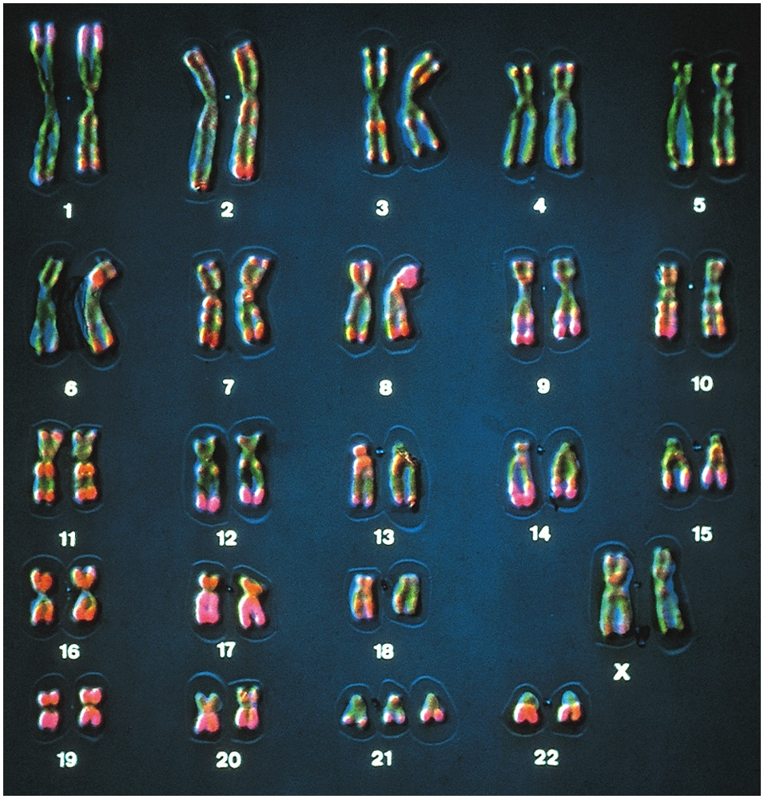
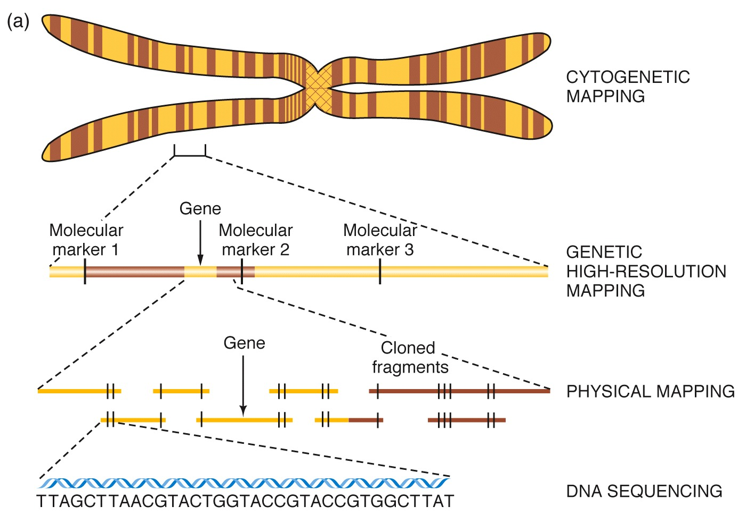
Intro to Biotech
Lect.15
Genomics
What is it?

Slide 2
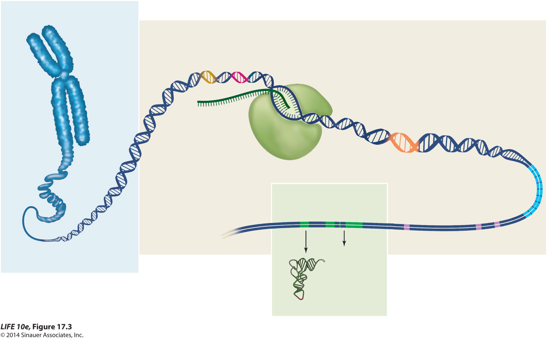
Intro to Biology
Lect. 2 JD
Genomics
What is a genome?
Complete set of chromosomal sequences
• organization of sequences:
Chromosome
Centromere sequences
Regulatory
sequences
Open reading frame
(protein-coding sequence: exons)
Telomere sequences
mRNA
Repetitive elements
rRNA genes
Transposons
tRNA

Slide 3
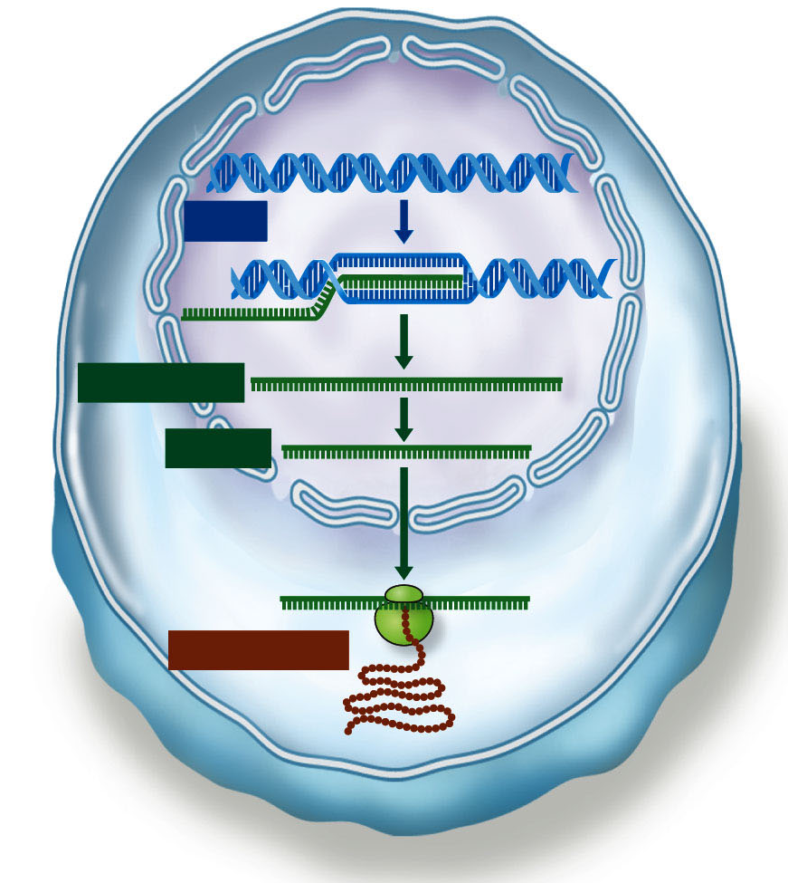
Intro to Biotech
Lect.15
Genomics
Gene
DNA
Transcription
Pre-mRNA
Processing
mRNA
Translation
Polypeptide
Ribosome
What is genomics:
Comparative
-
-
Functional:
-
-
Why? a. genetic/molecular studies of gene fxn.
b. blueprint for species
c. genome organization/evolution
d. therapeutic & diagnostic

Slide 4
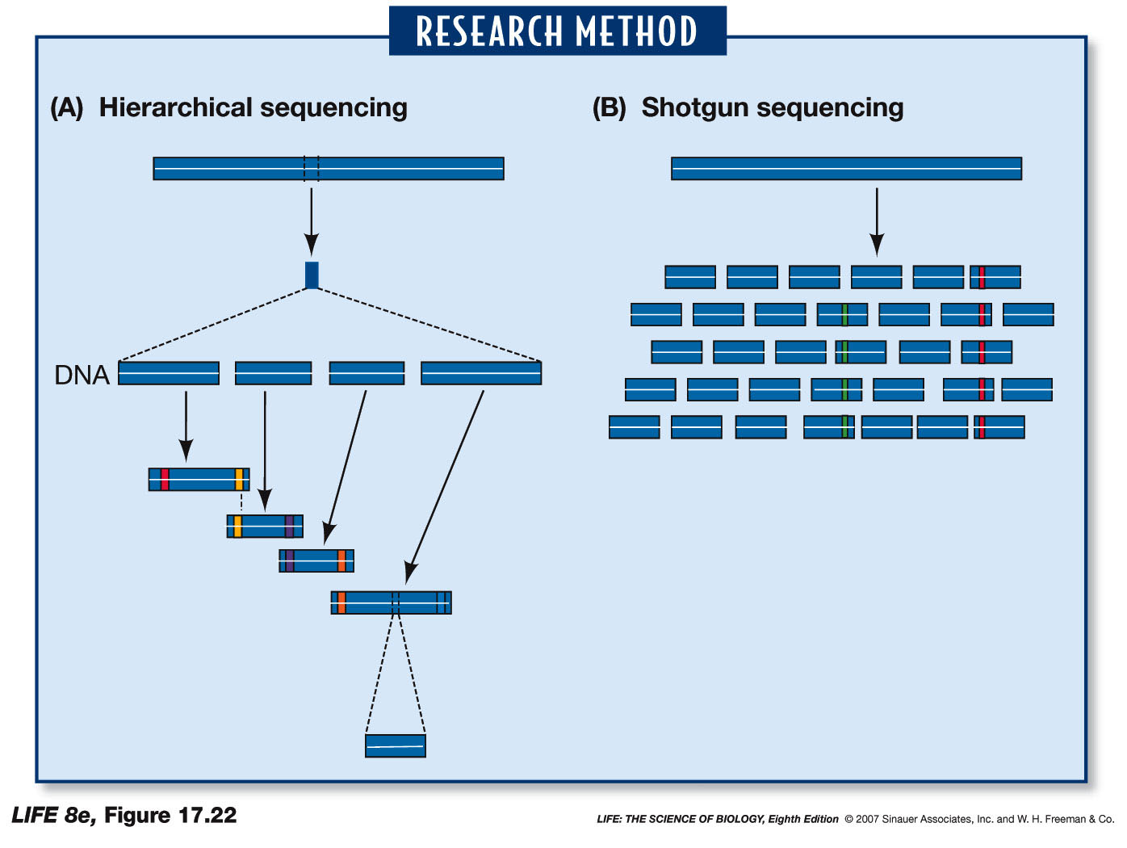
Intro to Biotech
Lect.15
Genomics
Genome sequencing
Hierarchical/directed
a. contigs
b. STS/EST
Whole genome shotgun
a. digest/clone
b. sequence

Slide 5
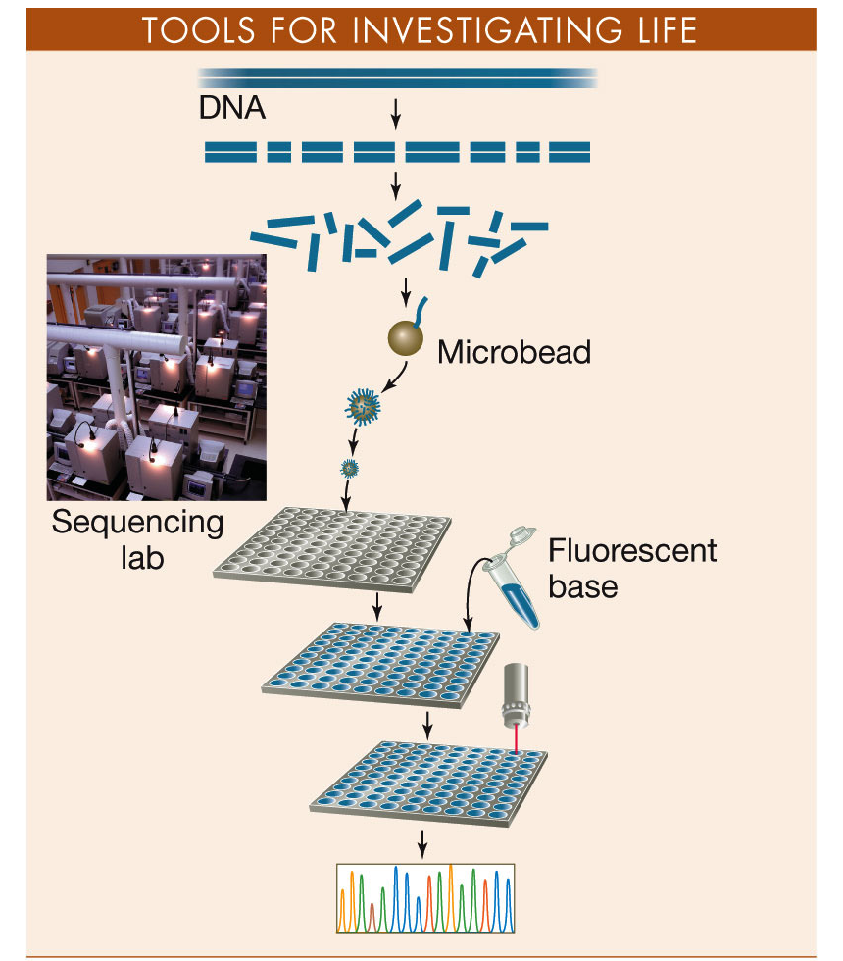
Intro to Biotech
Lect.15
Genomics
Genome sequencing
Whole genome shotgun
a. digest/clone
b. sequence
Novel Sequencing Technologies
Interface of Engineering, Physics, Biology

Slide 6

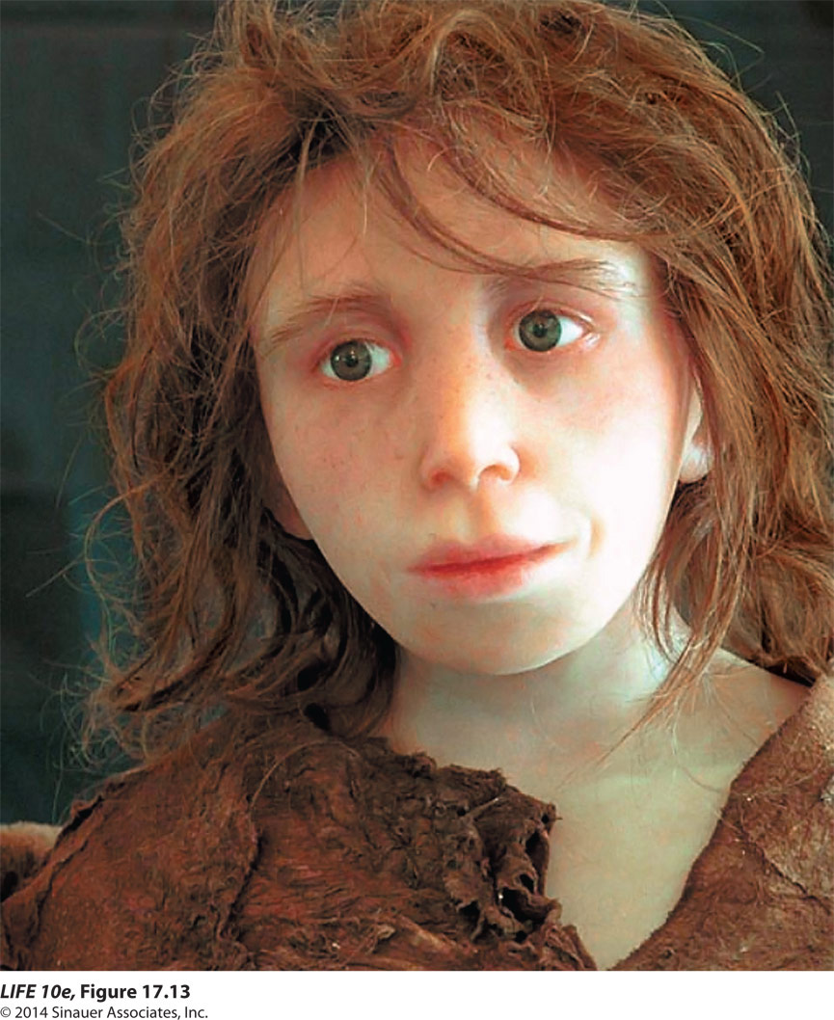
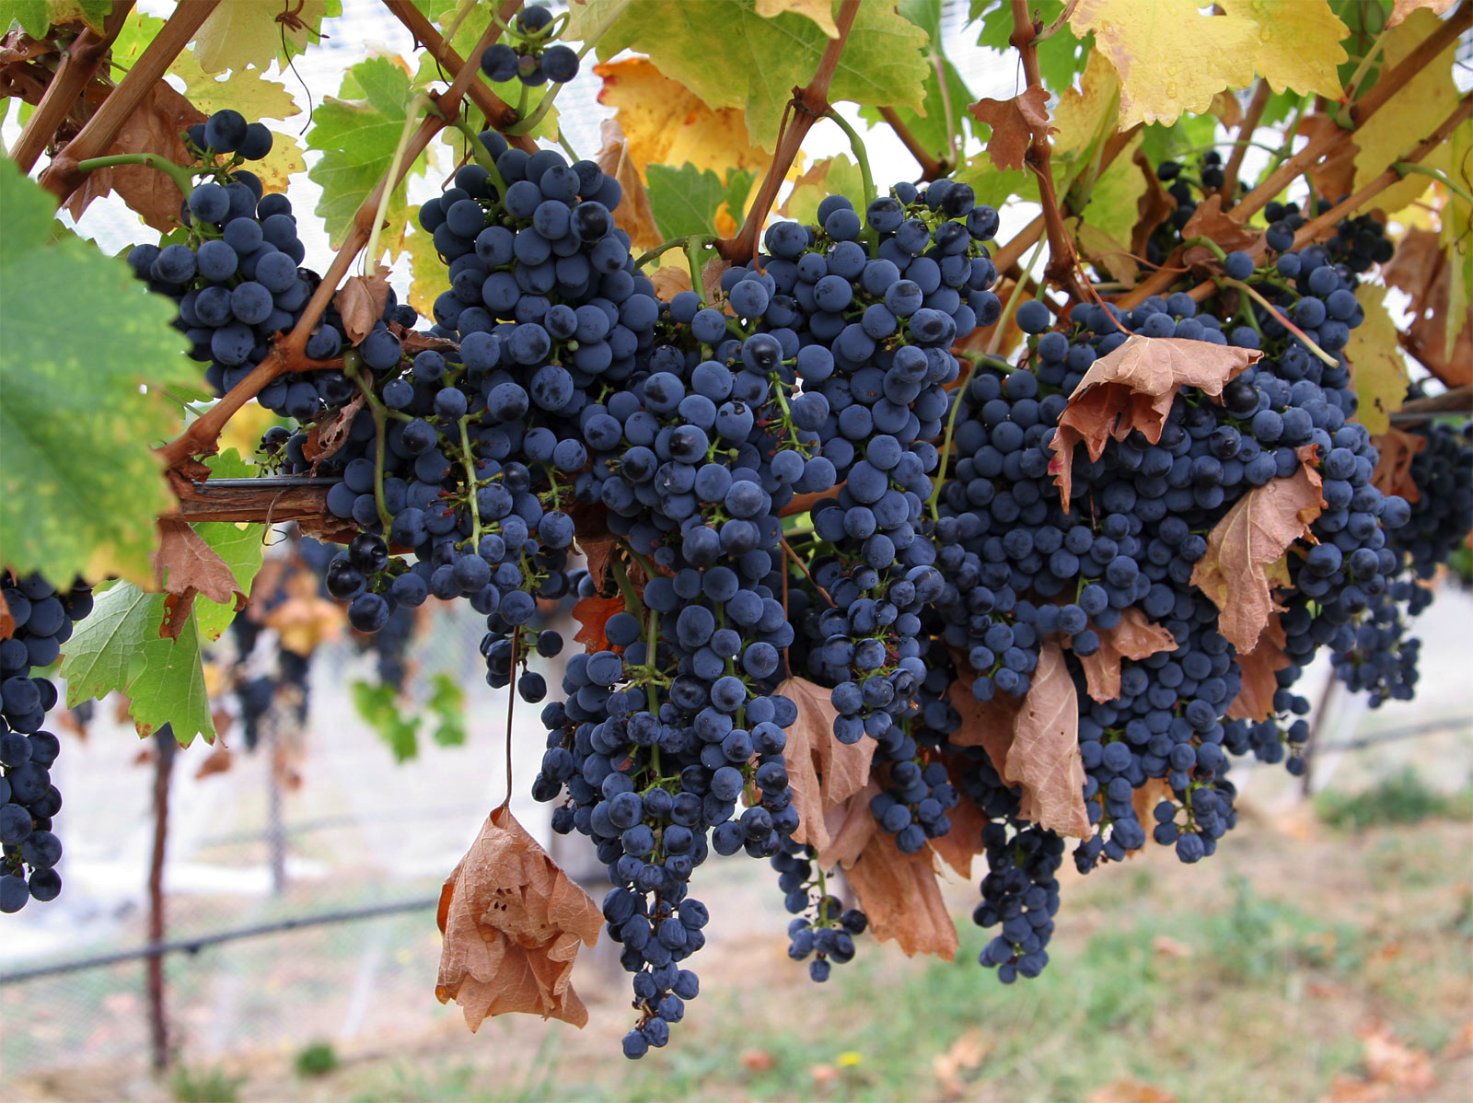
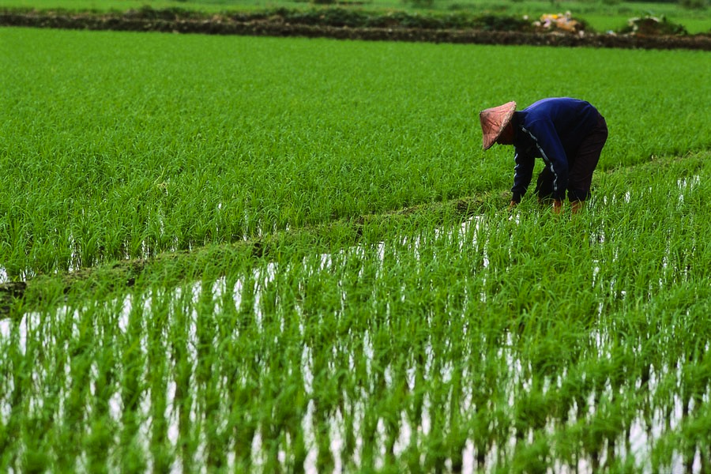
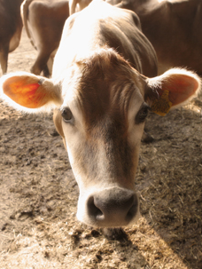
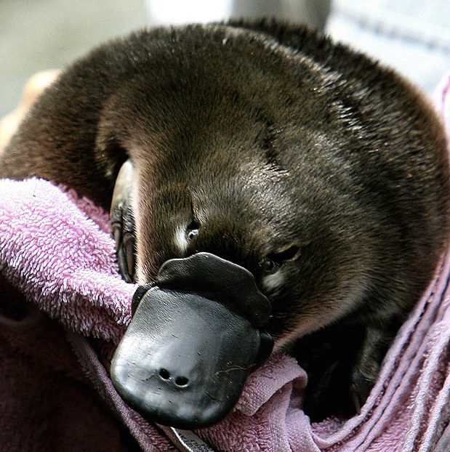
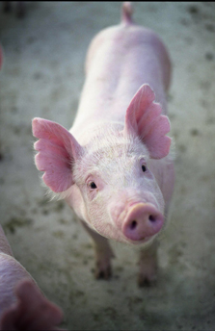
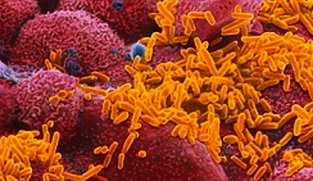
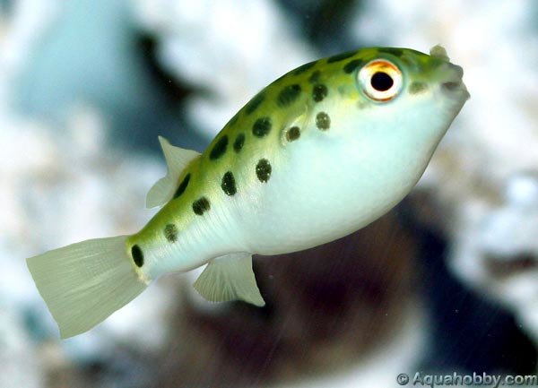

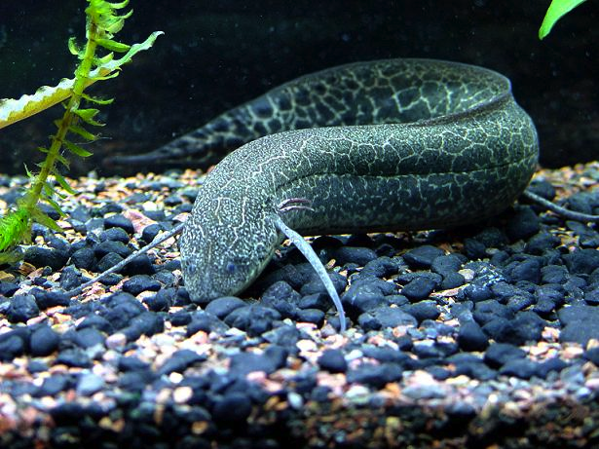
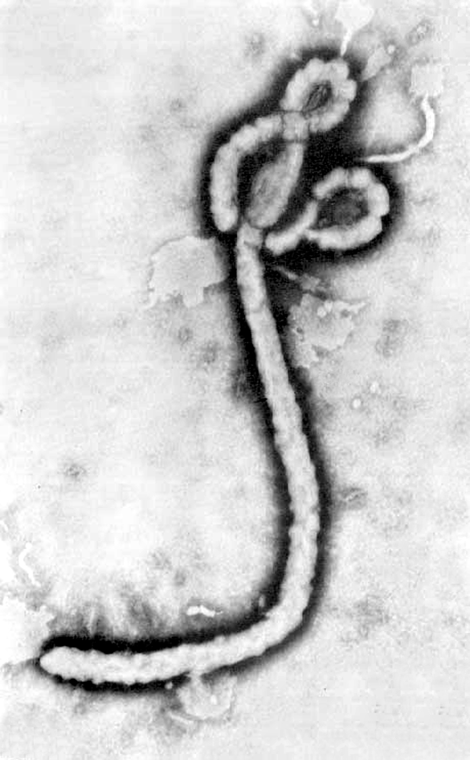
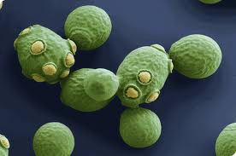
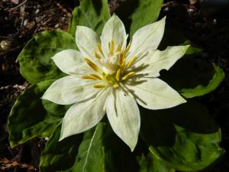
Intro to Biotech
Lect.15
Genomics
Eukaryotes > 311 (5000)
Plants
(soybean, grapes, corn, rice, barley,
tomato, banana,Papaya, apple)
20,000
42,653
Animals
18,500
Bacteria > 6829 (17,000)
1st H. influenza (1.8 x 10⁶ bp)
~1743 genes
- 1007 genes functional data (737??)
28,000
(anthrax, tuberculosis, strep, helicobacter pylori)
Viruses > 2510
(HIV, Hepatitis, Influenza, Smallpox
Ebola)
133Gb
Yeast
6,200
150Gb

Slide 7
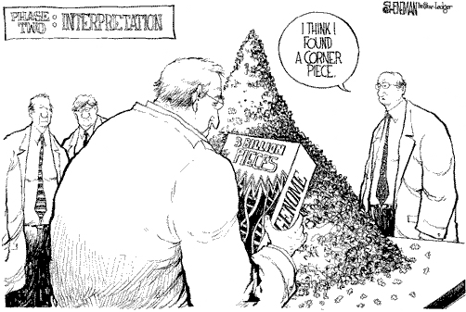
Intro to Biotech
Lect.15
Genomics
What is genomics:
- comparative
- functional
Comparative
- organize physical map
- sequence
identify all ORFs
compare across species
Functional:
- transcriptome
- proteome
What can this tell us?

Slide 8
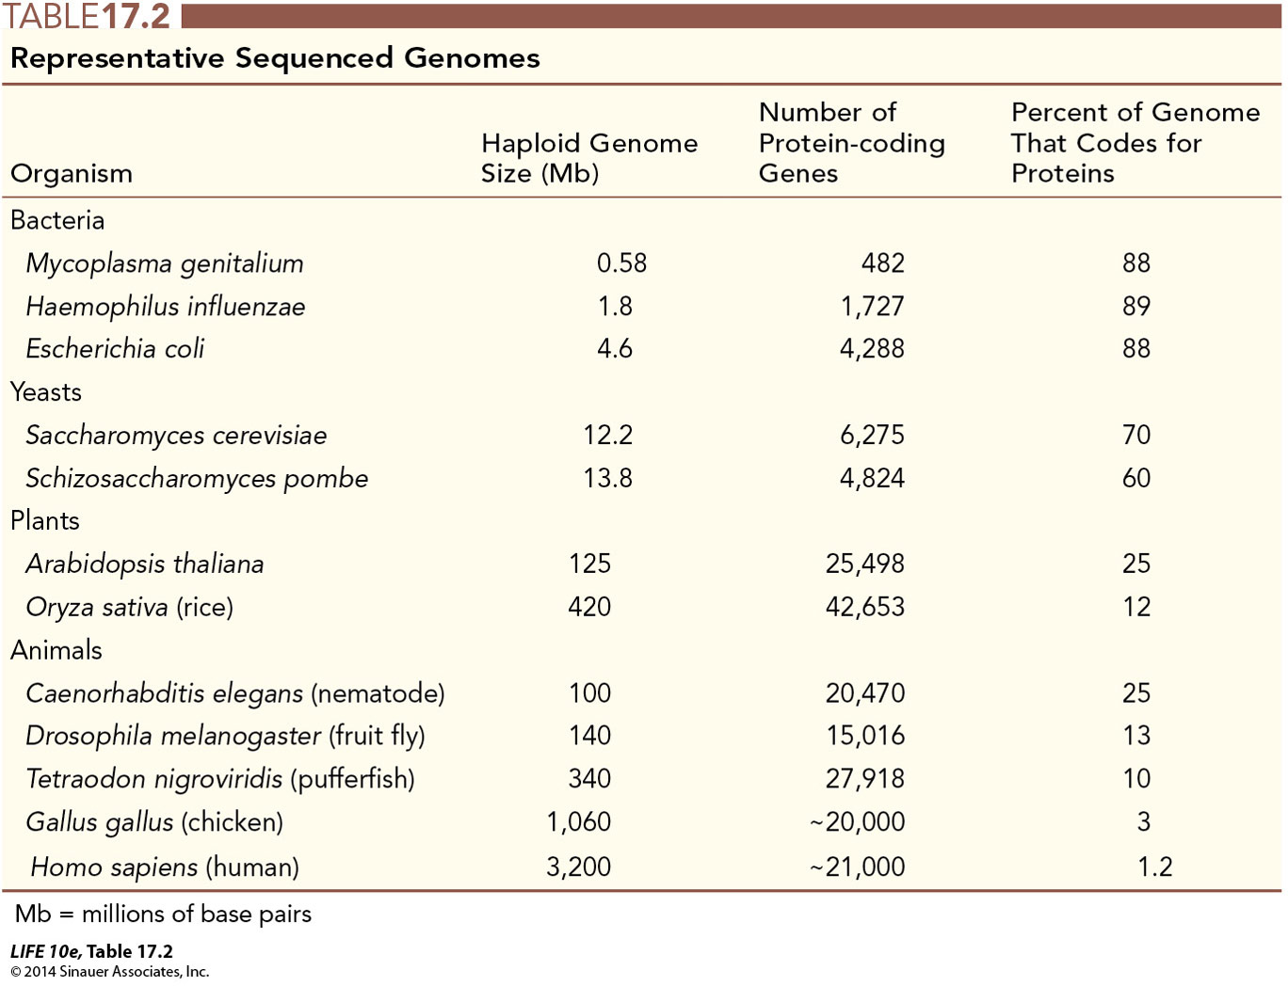
Intro to Biotech
Genomics
Lect.15
Genome sequences overview – What do genomes look like?
Genomics – Bioinformatics (Genome Wowser)
Analyze: informational content
- genes:
a.
b.
- noncoding

Slide 9
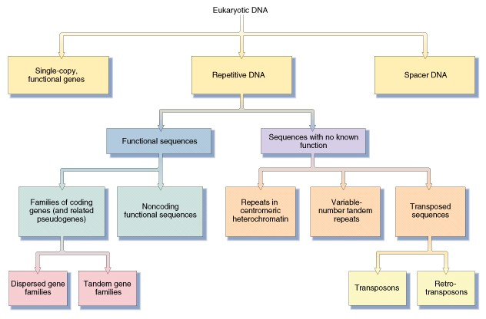
Intro to Biotech
Genomics
Lect.15
Genome sequences overview – What do genomes look like?
1. highly repetitive:
- minisatellite (10-40nt repeat, 1-5kb length)
- microsatellite (1-3nt repeat, 15-100 copies)
2. Moderately repetitive: tRNA, rRNA
3. Transposons (mobile genetic elements)
• LINES: 1-7kb in length, 20,000-40,000/genome (17%)
• SINES: Alu repeat, <500nt length, 1.5 million/genome (15%)
• Retrotransposons: 1.5-11kb in length, (8%) (retroviruses…)
• DNA transposons, 1-3kb in length, 300,000/genome (3%)

Slide 10
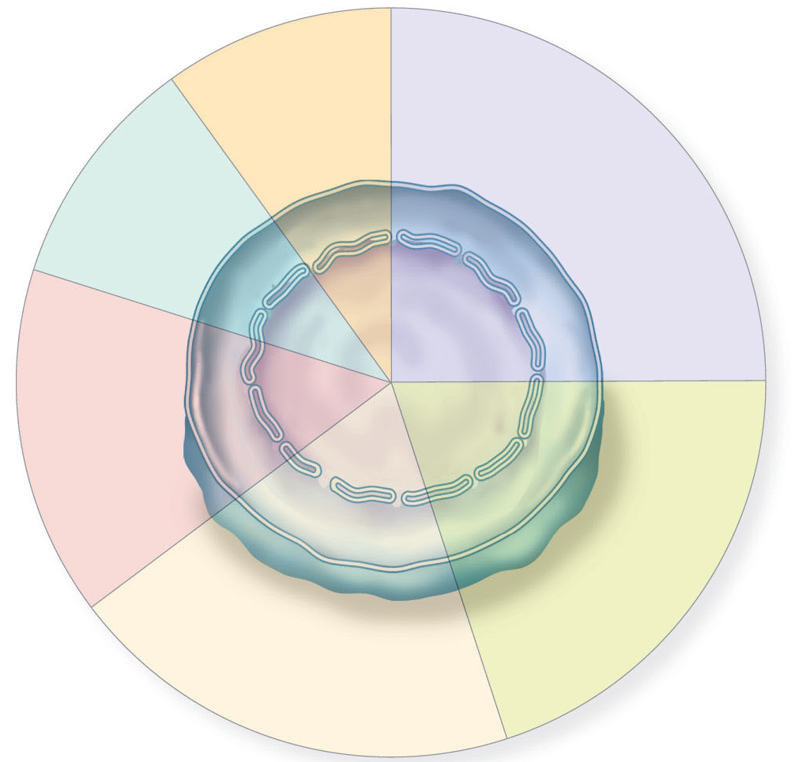
Intro to Biotech
Lect.15
Genomics
What do genome sequences reveal?
Cell
signaling
Enzymes
for general
metabolism
Cell cycle
10%
10%
25%
Cell structure
and organelles
15%
20%
20%
DNA replication,
maintenance,
and expression
Membrane structure
and transport

Slide 11
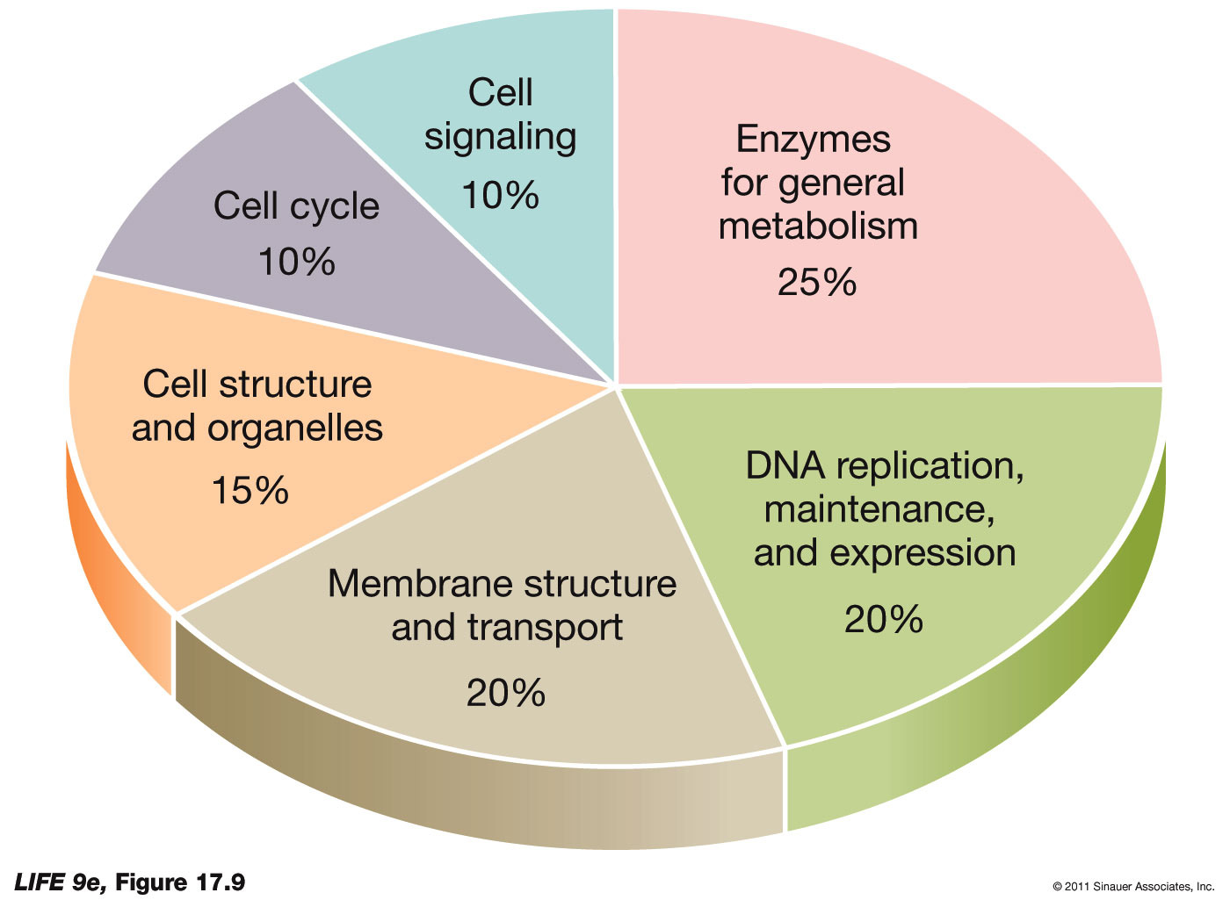
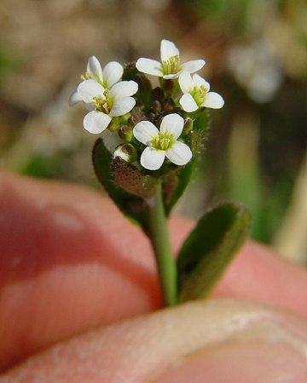
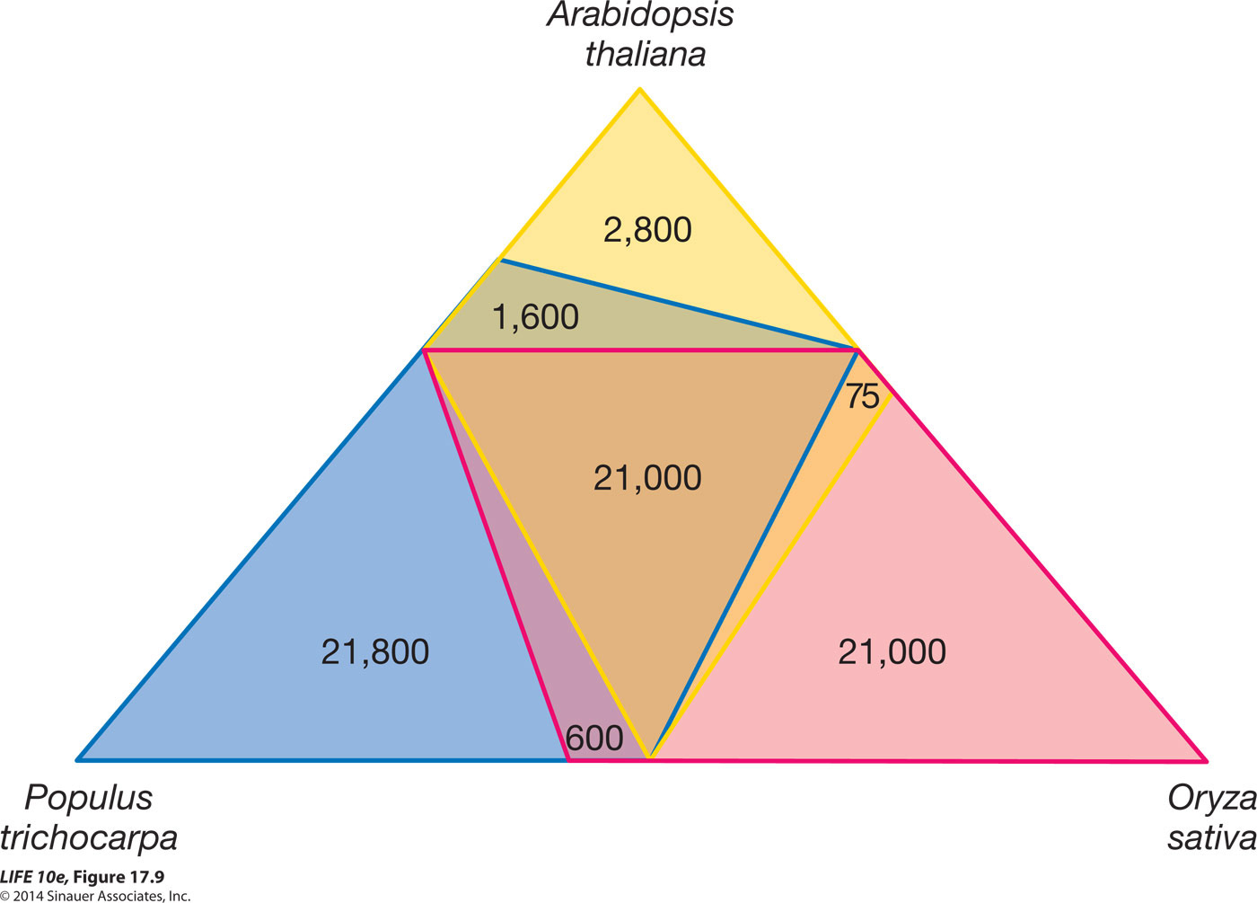
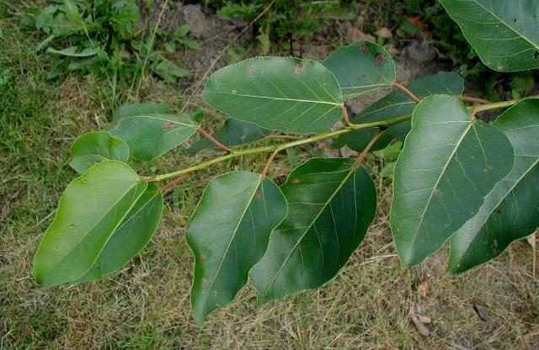
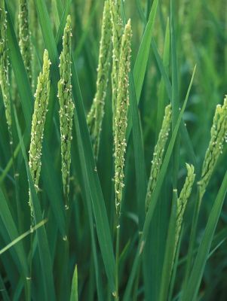
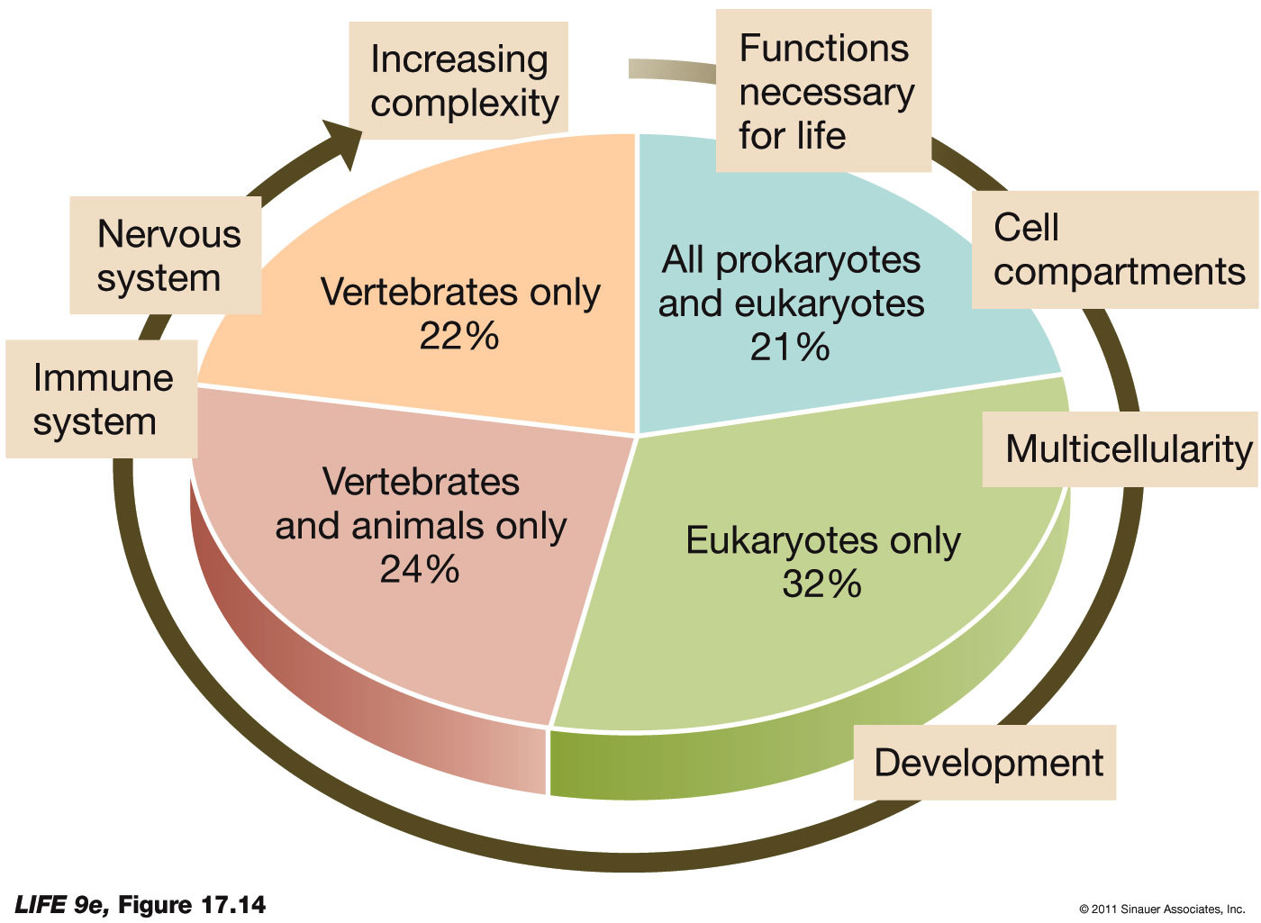
Intro to Biotech
Genomics
Lect.15
What do genome sequences reveal?

Slide 12
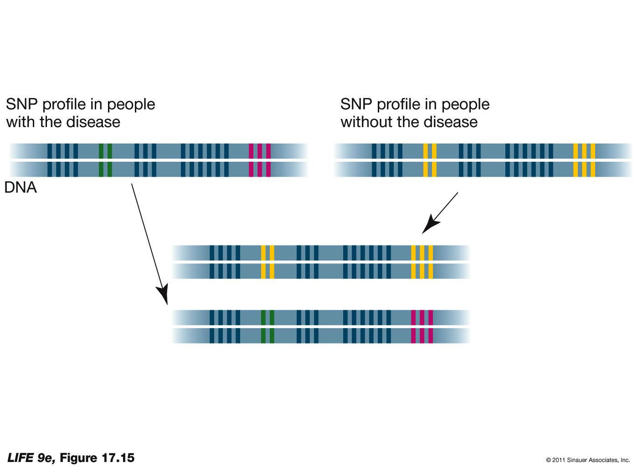
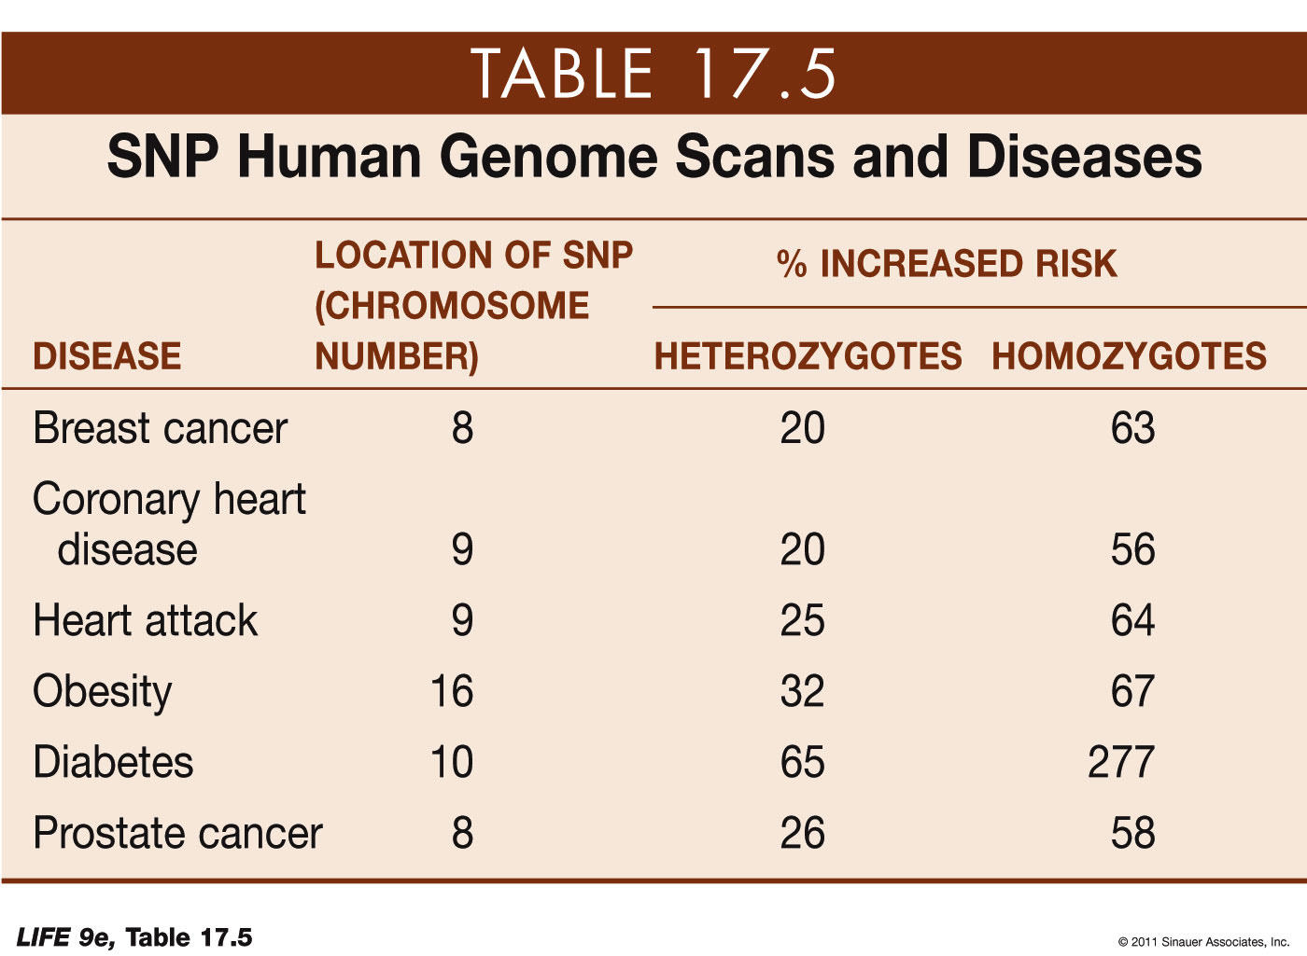
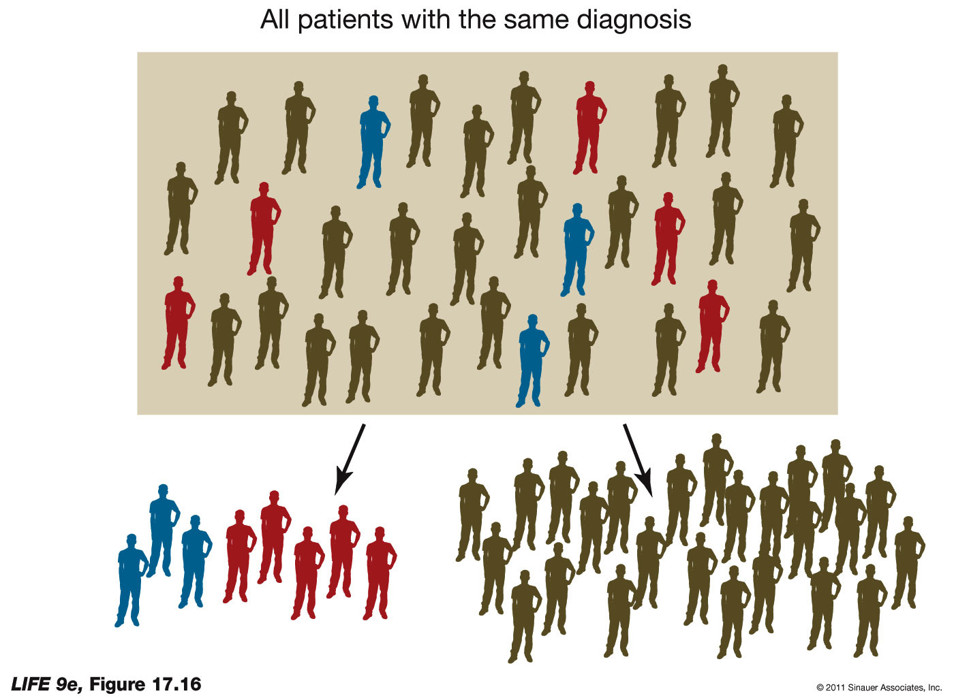
Intro to Biotech
Genomics
Lect.15
Sequence - how do we use info?
Pharmacogenomics

Slide 13
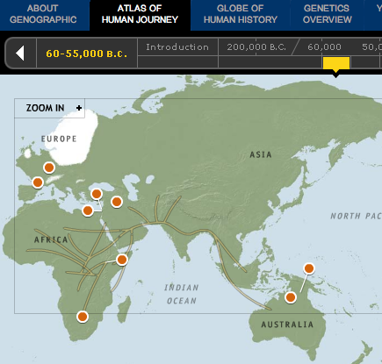
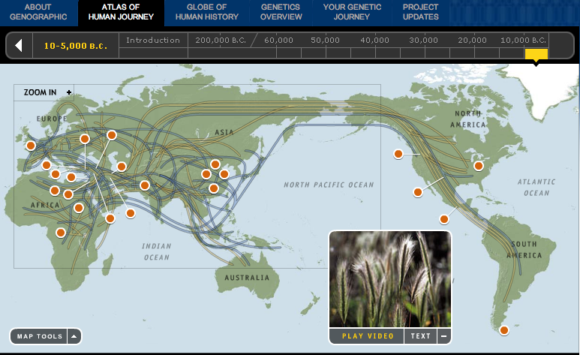
Intro to Biotech
Genomics
Lect.15
Sequence - how do we use info?

Slide 14

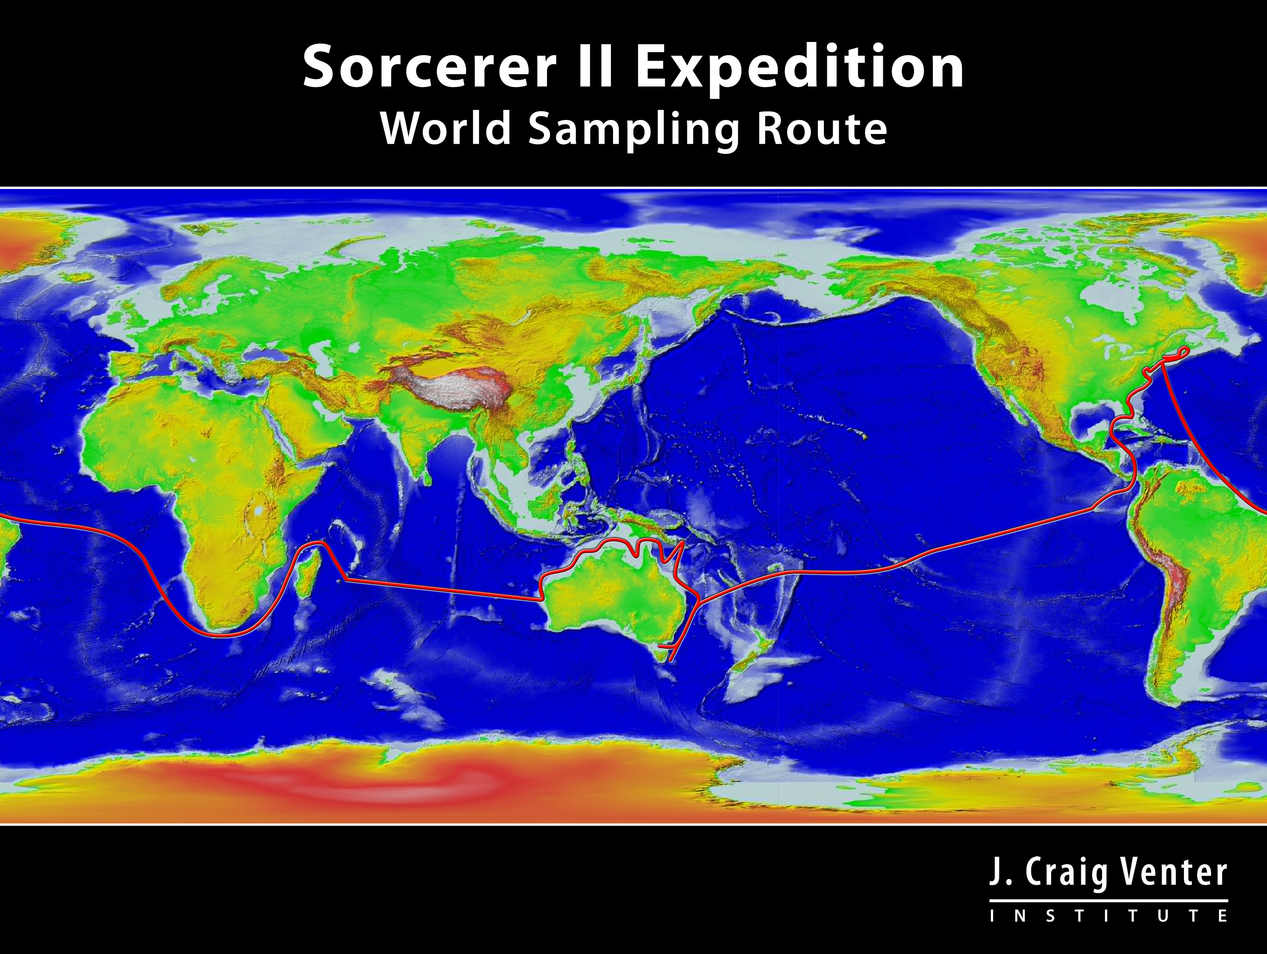
Intro to Biotech
Genomics
Lect.15
Sequence - how do we use info?
Sequencing capability
Computational tools/power
What can we do with metagenomics?
Sorcerer II voyage:
- diversity of prokaryotic life across the planet in oceans
- 200l sea water every 200 miles circumnavigating earth
Global Ocean Sampling (GOS) sequences

Slide 15
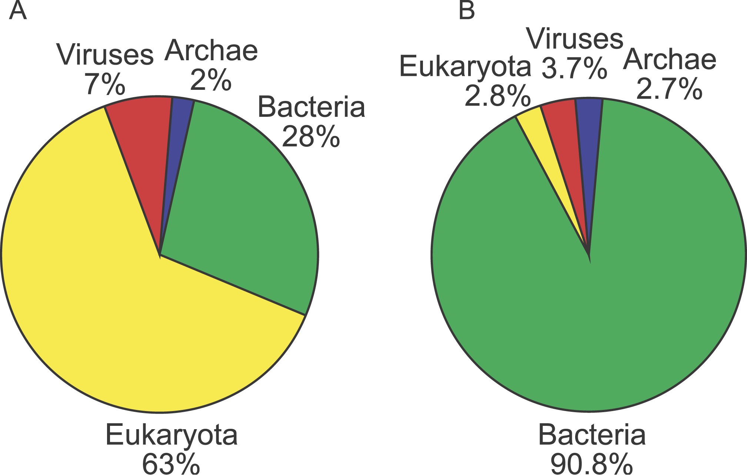
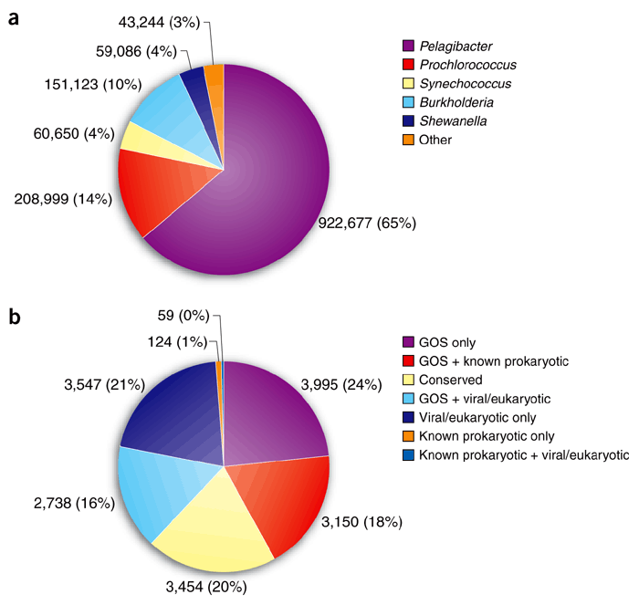
Intro to Biotech
Genomics
Lect.15
Metagenomics
Sorcerer II voyage:
- 6.25 gigabases of prokaryotic sequence
- 41 different locations (10 off the Galapagos)
- represents ~5.7 million nonredundant protein sequences
1.8 TIMES NUMBER OF SEQUENCES
AVAILABLE IN PUBLIC DATABASES!
Public
GOS

Slide 16

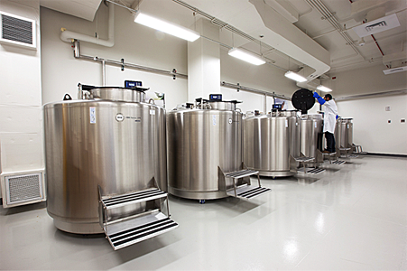

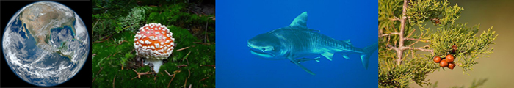
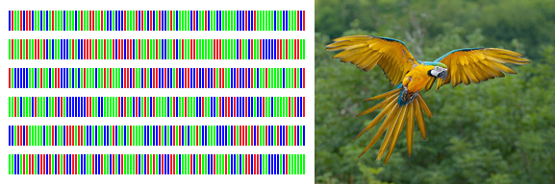
Intro to Biotech
Lect.15
Genomics
Sequence - how do we use info?
Sequencing capability
Storage

Slide 17
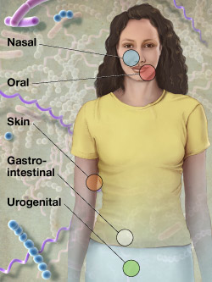
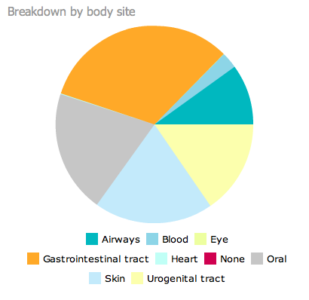
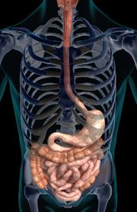
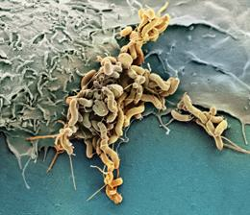
Intro to Biotech
Genomics
Lect.15
Metagenomics
Human microbiome
Goal = microbes in human body
and whether changes in microbiome are related to health and disease.
Joshua Lederberg
• 10:1 microbes to human
• 4.4lbs
• 300 people, 18 sites
• 12,000 samples
Enterotypes
• Bacteroides,
• Prevotella
• Ruminococcus

Slide 18
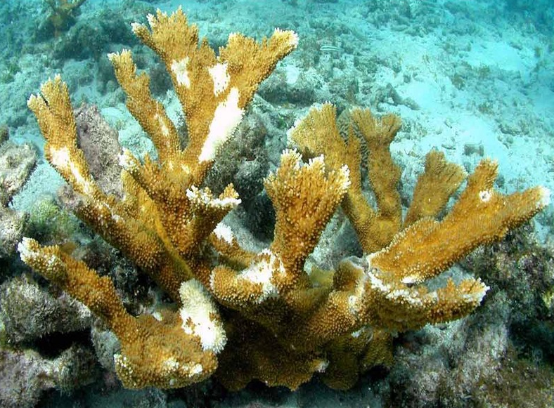
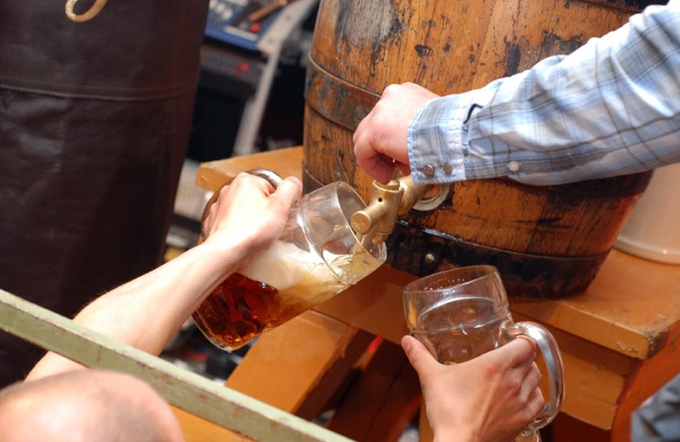
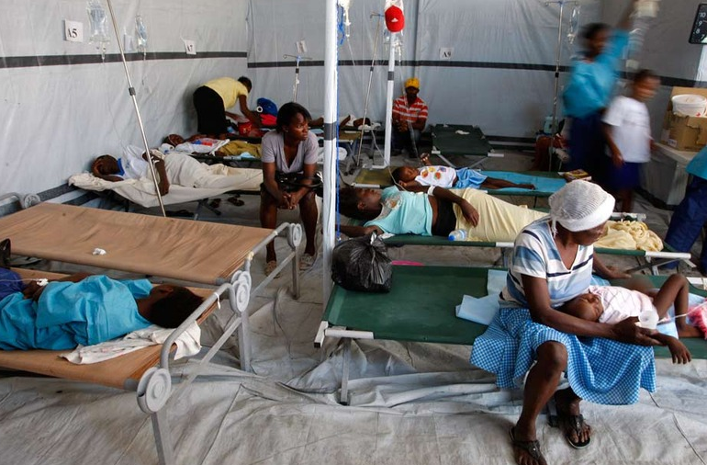
Intro to Biotech
Genomics
Lect.15
Monitor Ecosystems…
white pox
Environment: Elkhorn coral
- 90% decline in population
- linked to Serratia marcescens
- gut bacteria
- genetic fingerprint = human
Understand food sources
Agriculture: Lager beer (cold)
- Saccharomyces carlsbergensis
- S.cerevisiae – 37ºC
- yeast Patagonia oak trees
- S. eubayanus!
Epidemiology
Cholera Outbreak
- Haiti earthquake
- UN peacekeepers
- poor sanitation (6000 dead)
- genome analysis=peacekeepers

